Slide 1


Smart solutions, seamless success
1

Slide 2
Meet the Design IT Team
Belma Vazquez
Meerub Sultan
Project Manager with strong communication and organizational skills
Assistant Manager bringing valuable user insights to the team.
Linda Lopez
Kyla Kemp
Front-end Developer skilled in building responsive, user-friendly interfaces.
Visual Designer with a keen eye for aesthetics and branding.
Manya Gogia
Tawhida Farrag
Backend Developer with expertise in creating secure and scalable applications.
Data analyst lead with a strong background in quantitative analysis and data visualization techniques.
Huda Memon
Alondra Cisneros
Content Strategist who ensures our projects are engaging and informative.
QA Tester who guarantees a smooth and bug-free user experience.
2

Slide 3
Outline
1
Overview
2
Analysis
3
Solution #1
4
Solution #2
5
Prototype
6
Summary
7
Lessons Learned
8
Q&A
3

Slide 4
Overview
Streamline custom order management
Application system design
Focused on reducing errors
Boost customer retention
Saving time when taking orders
4

Slide 5



Objective
Improve order management and customer retention.
Aiming to reduce the time when handling orders.
Reduce the number of lost orders.
Avoid duplicate orders.
Define the roles and responsibilities for efficient operations
Create a system to take care of customer management
Allow for staff to spend less time taking orders and handling them
System is designed with a focus on customer
Clear idea on customer needs by tracking sales and inventory
5

Slide 6
Analysis
Problem identification
Objective definition
Requirements gathering
Identified inefficiencies in custom order management:
Set clear goals to approach problems:
Assessed business needs for a system that is focused on:
Lost or duplicated orders
Reduce errors
Managing customer information
Manual tracking
Minimize time spent handling orders
Limiter customer data access
Real time order tracking
Improve customer retention
Update product options
Integrate with sales
6
Notes:
Alondra

Slide 7
System Solution #1
Simplify order creation process
Assist with real time tracking
Eliminate lost and duplicate orders
Increased customer retention
Improve customer data management
7

Slide 8





Required Hardware
Desktop computer
Monitor
Laptops
2 Dell XPS Desktop
1 Dell 27 4K UHD Monitor
2 Dell XPS 13
Upgraded router and modem
Terminal
1 X-Fi Gateway
2 Square POS terminal
8

Slide 9




Recommended Software
Custom Cake Ordering & Customer Management GUI
Square POS software
Shopventory
Backblaze
9

Slide 10
Feasibility Analysis
Total cost of ownership
1
Basic Plan: $4,578.95 + $130/month + transaction fees​
Custom Plan: $4,578.95 + $180/month + transaction fees
Ongoing cost
2
Basic Plan: $130/month + transaction fees​
Custom Plan: $180/month + transaction fees
10

Slide 11
Breakeven Analysis
11

Slide 12
Recommendation
1
Increase client retention
Our solution provides the business to store all relevant information of customers
2
Improved way to handle returning customers
By implementing our system, it is easier to handle future orders and assess customer needs
3
System allows for insights in customer needs
Allows for staff to be aware of what the customer is interested, as well as keeping track of inventory
4
Enhance business
This solution will provide success in a competitive market
12

Slide 13
System Solution #2
User friendly interface to place orders.
Allows for real time order tracking.
Stores data in a digital manner.
Prevents duplicates.
Seamlessly integrates with the current workflow of your business.
13

Slide 14







Required Hardware
Desktop computer
Tablets
POS terminal
2 Desktop HP All-in-one27-cr0000m
2 Apple - 10.9-Inch iPad - Latest Model - (10th Generation)
1 Toast POS system
Receipt printer
Upgraded router and modem
Label printer
2 TOAST terminal receipt printer
Netgear Nighthawk AX/5-Stream AX2400 Wi-Fi 6 Router, Black, RAX30-100NAS
2 Brother QL-800 High Speed label printer
Barcode scanner
2 Zebra Symbol LS2208 Corded Barcode Scanner
14

Slide 15
Required Software
Dropbox for business
TOAST POS
Web design + Domain + Customer management GUI
9 TB of cloud storage
Custom configuration
Our recommended design for application of the website
15

Slide 16
Feasibility Analysis
Total cost of ownership
1
Basic Plan: $3,555 + $130/month + transaction fees​
Business Plan: $3,555 + $200/month + transaction fees
Ongoing cost
2
Basic Plan: $45/month + transaction fees​
Business Plan: $190/month + transaction fees
16

Slide 17
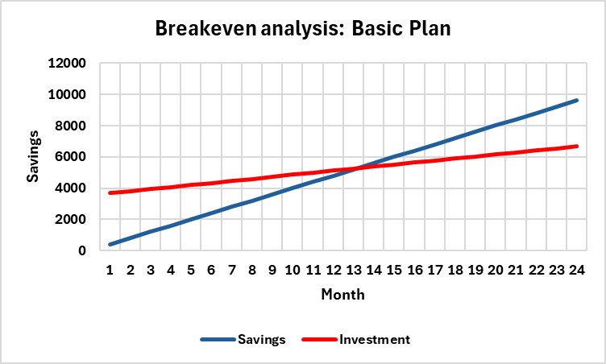
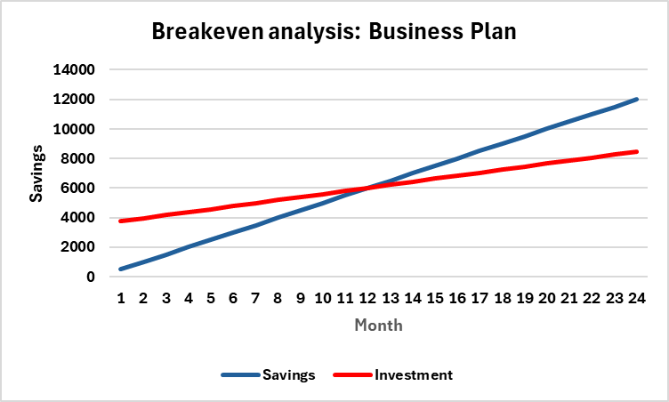
Breakeven Analysis
17

Slide 18
Recommendation
1
Implement the recommended system
We expect to have a 25% reduction for the time that takes to create a custom order
2
Implementing the new system is a process that will be broken down in phases
Ensure a seamless transition as well as minimize downtime
3
Sales staff will be able to enter orders directly into the system
The system will streamline workflows for your sales,
4
System will also help users by updating them of real time inventory on product
Business can also avoid overstock as well as understock ingredients.
18

Slide 19
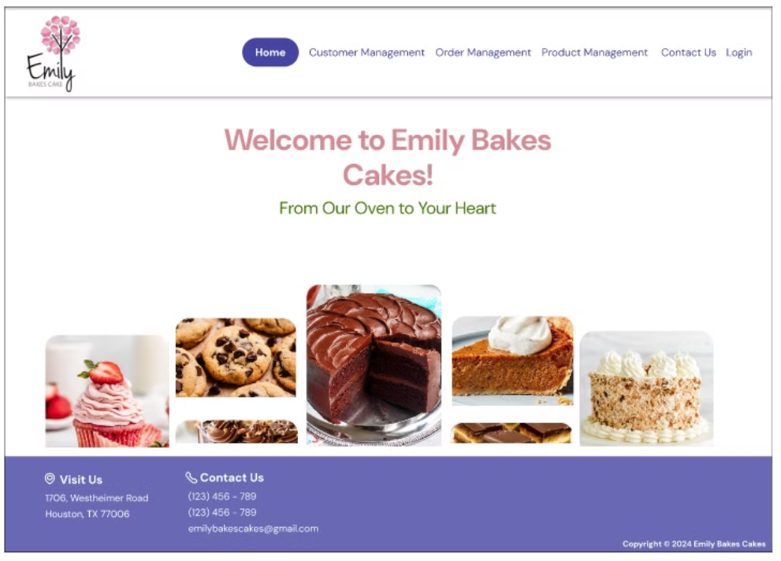
Prototype
19

Slide 20
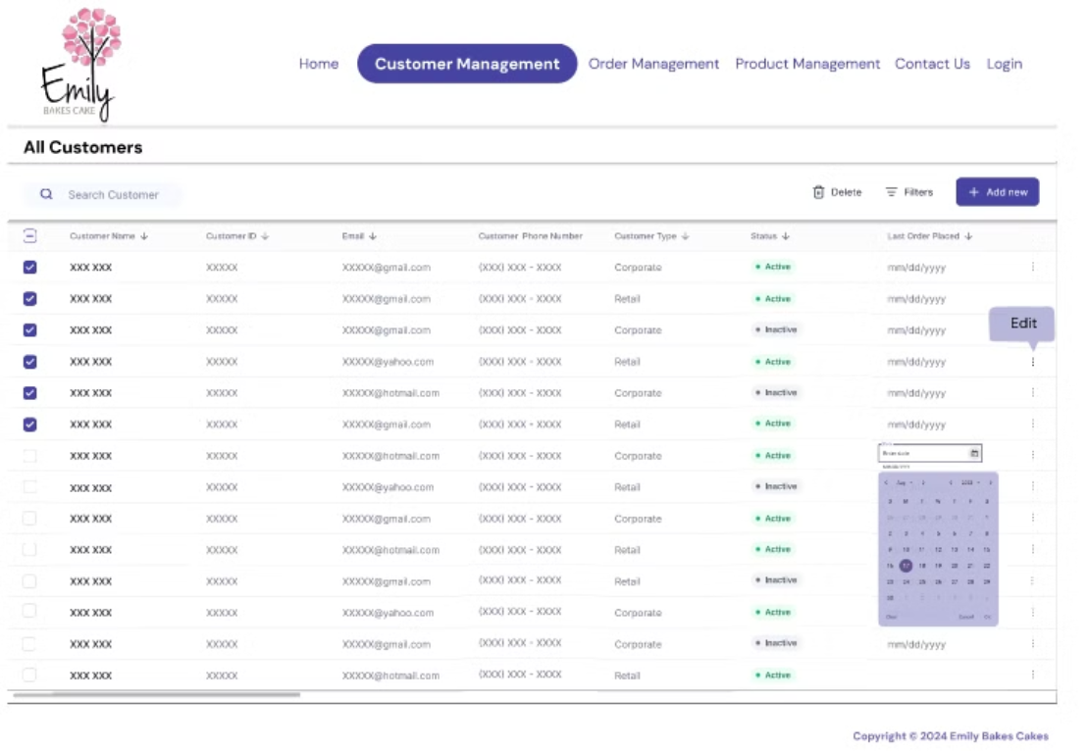
Prototype
20

Slide 21
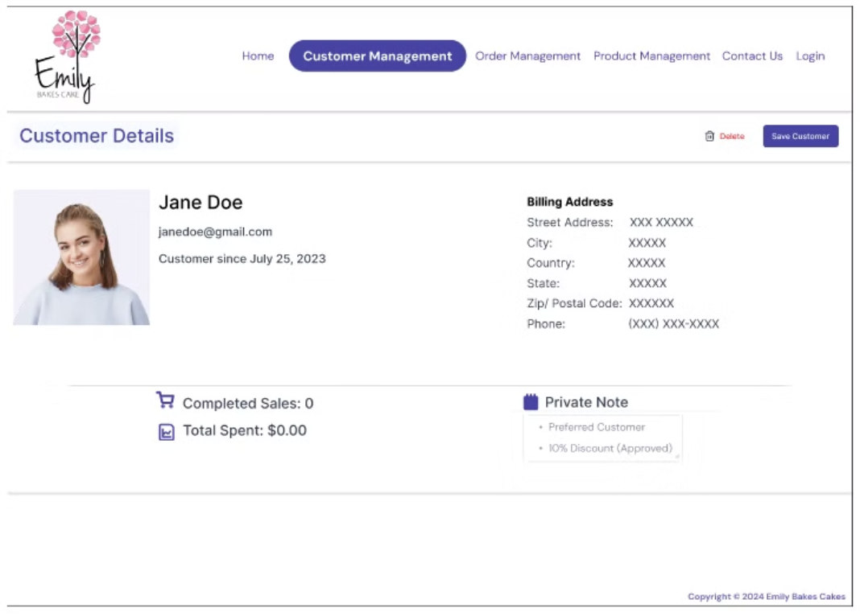
Prototype
21

Slide 22
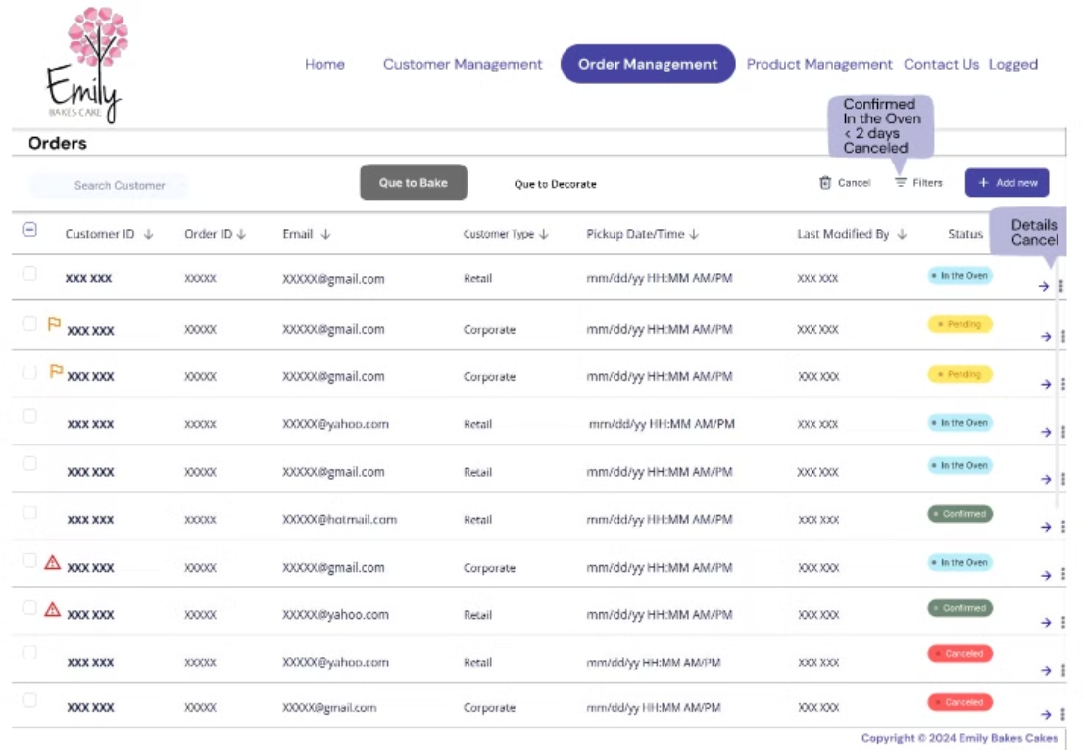
Prototype
22

Slide 23
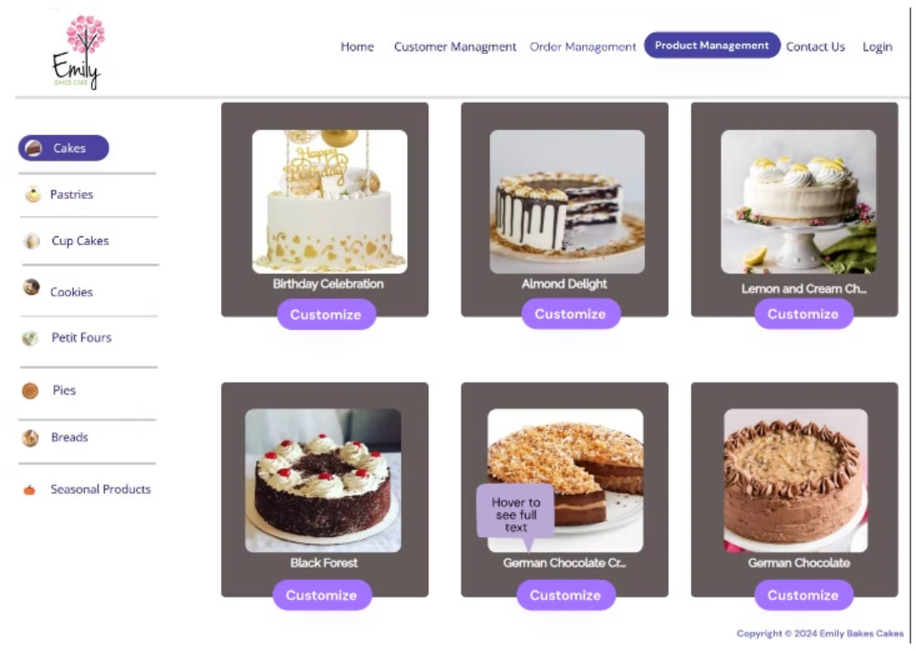
Prototype
23

Slide 24
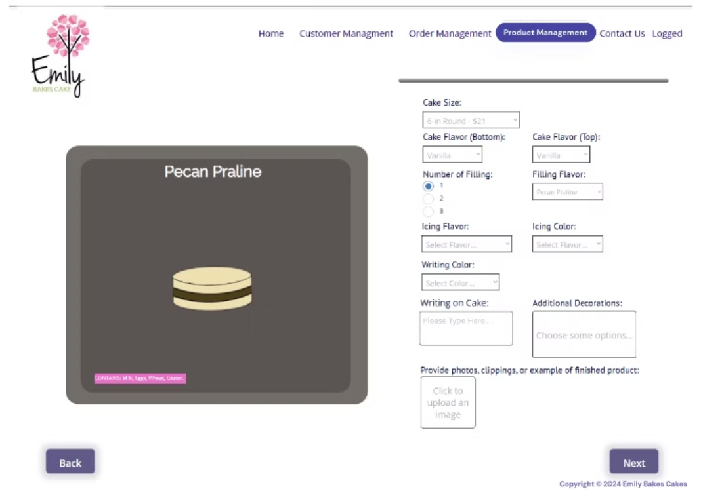
Prototype
24

Slide 25
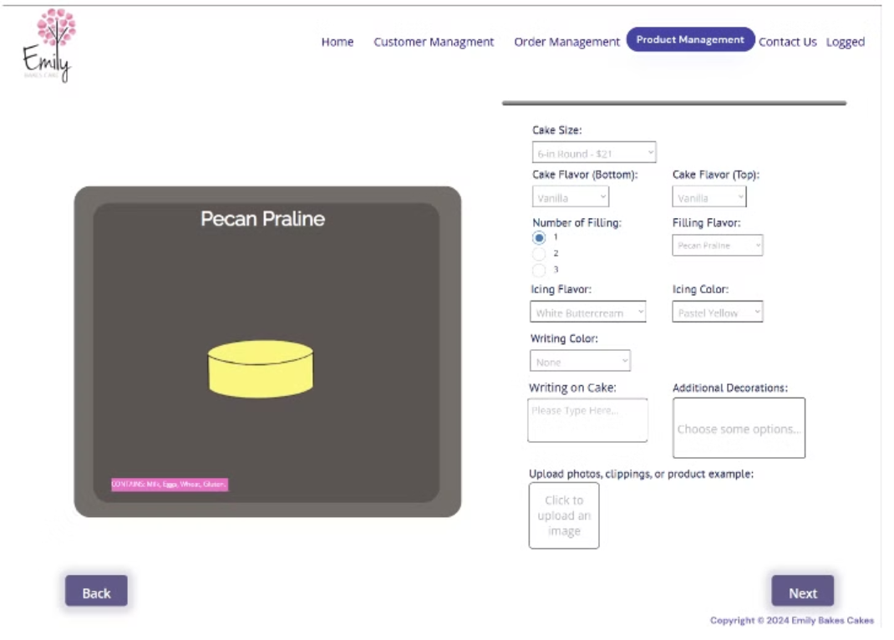
Prototype
25

Slide 26
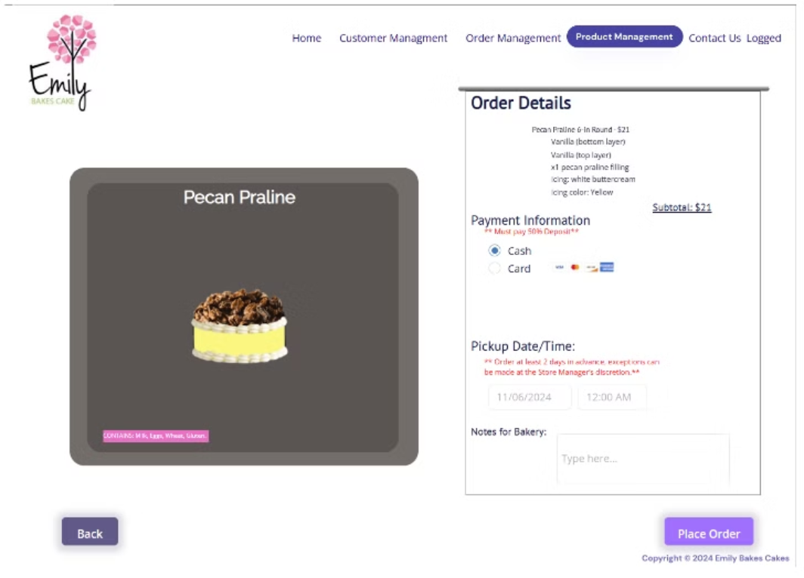
Prototype
26

Slide 27
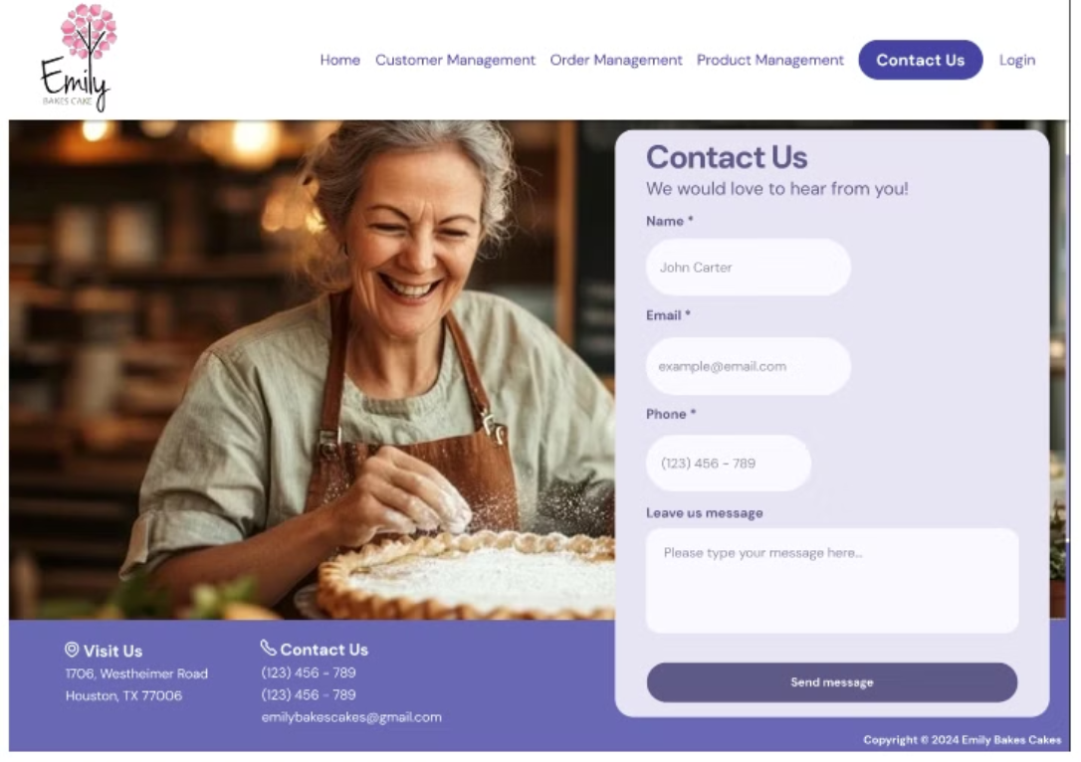
Prototype
27

Slide 28
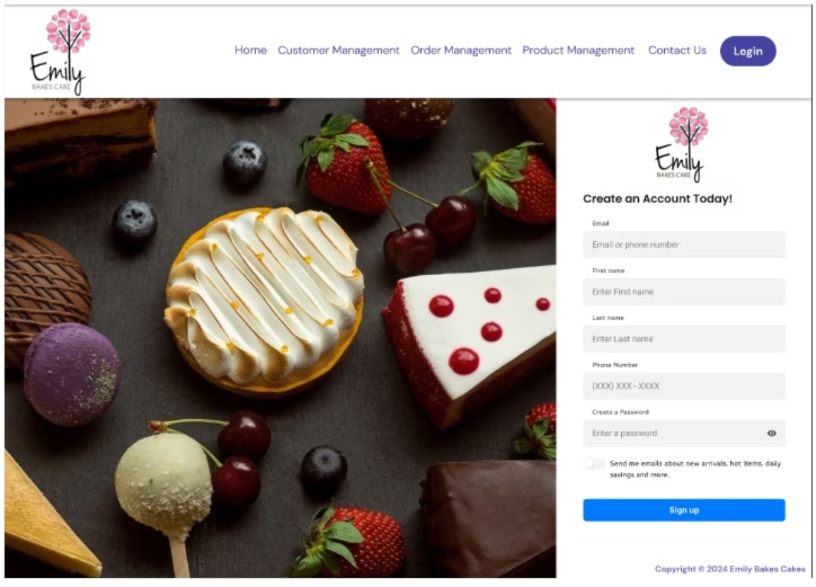
Prototype
28

Slide 29
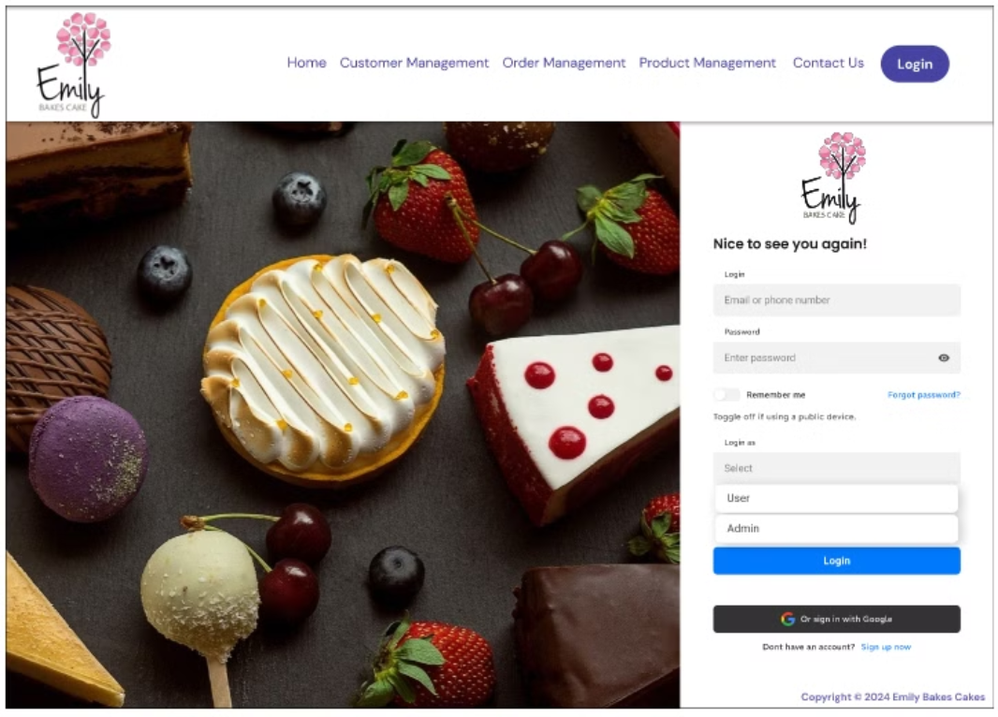
Prototype
29

Slide 30
Lessons learned - What worked?
1
Having deadlines
2
Clear objective
3
Common goal
Helped having things on time for quality check
Knowing what was needed to achieve
Having a common goal helped to give our best in each deliverable
30

Slide 31
Lessons learned - What did not work?
1
Multitasking
2
Having unrelated assignments
3
Role orientation
Working on different things at the time. Constantly lost focus
Assignment of deliverables should have been done depending on role.
Working on very different parts of the project at the same time.
31

Slide 32
What could be done differently?
1
Organization
2
Communication
3
Reasonable and timely deadlines
Having files across different applications and channels made things confusing and often hard to find.
Having more than one meeting a week would have been optimal.
Ensure everyone had a clear understanding of the material.
32

Slide 33
Summary
1
Project goal
2
Objective
3
Expected outcome
Implement the recommended system for custom order management
Reduce order errors, save staff time, boost customer retention
Lower operational costs, increase repeat business, and improve efficiency
33

Slide 34

Q&A
34

